Slide 1
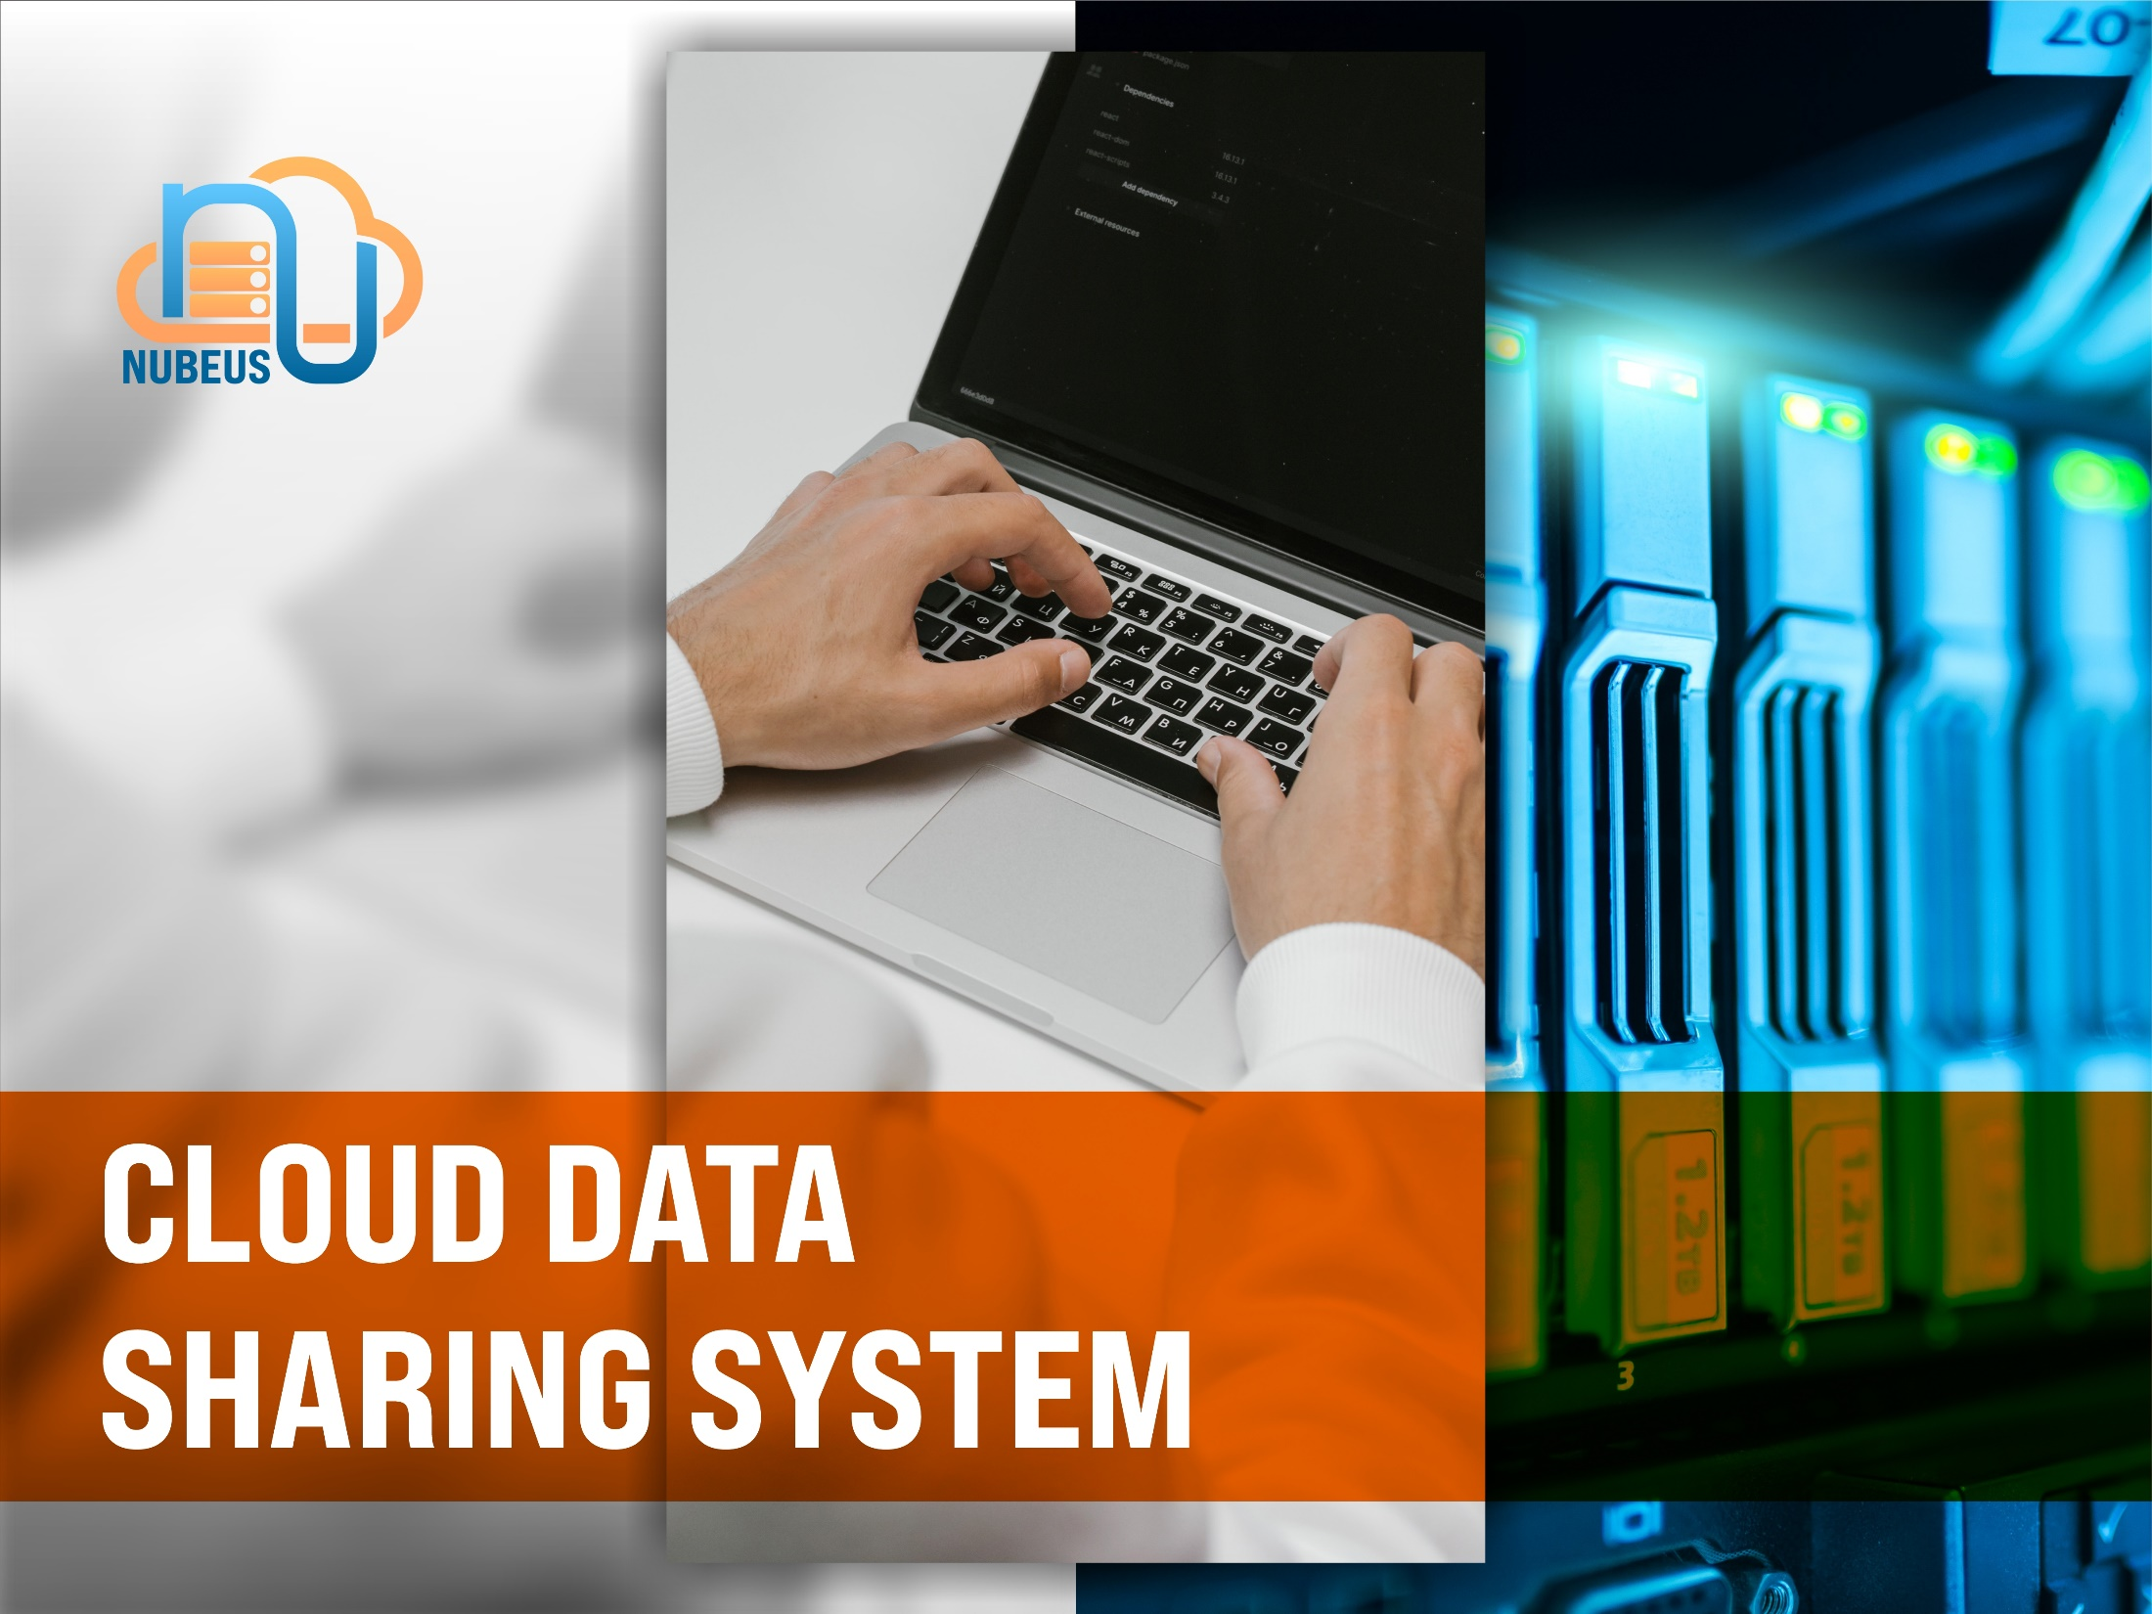

Slide 2

OVERVIEW
This system is needed to perform File/Data sharing in the internal environment of an agency.
This device is a client server software that provides services such as Dropbox, Google Drive or also iCloud, which can be installed in the agency's internal environment, so that its capacity can be very large, and safe.

Slide 3
FEATURES
This facility is used to share hydrographic data between Pushidrosal staff
Easy collaborative editing for textual data and spreadsheets

Slide 4
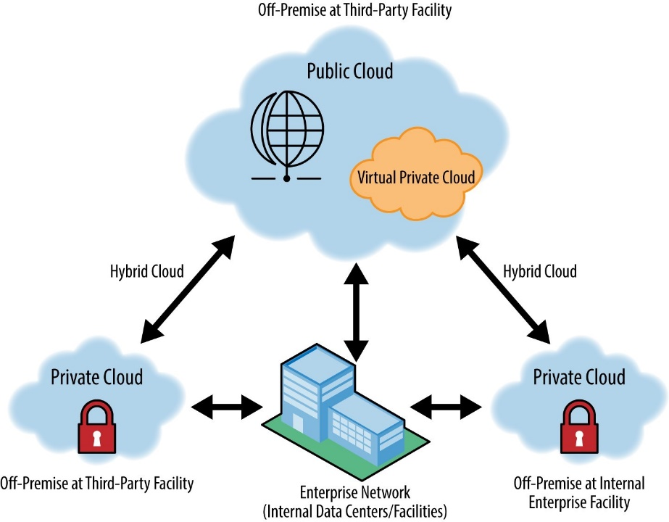
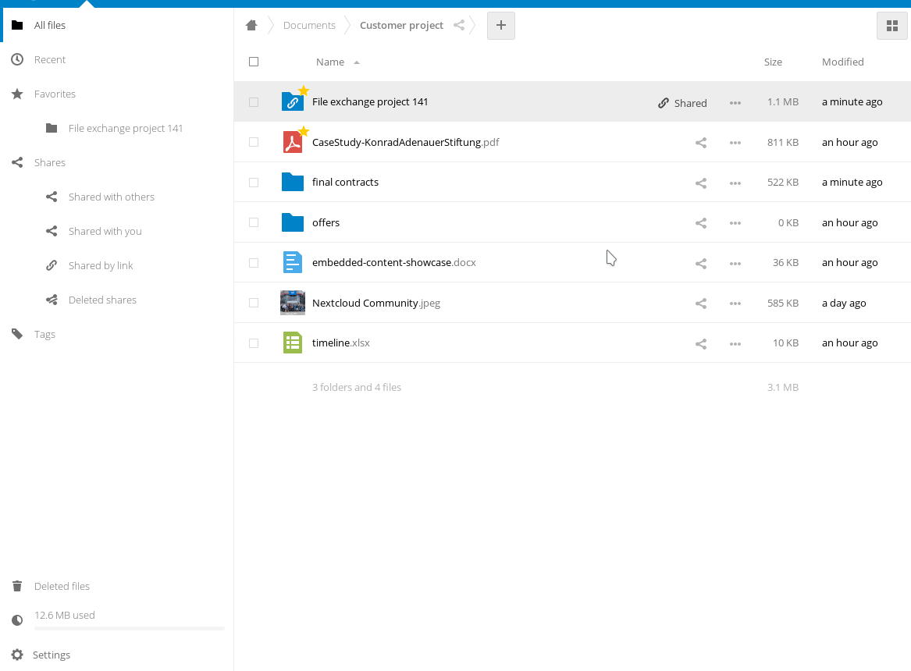

Slide 5

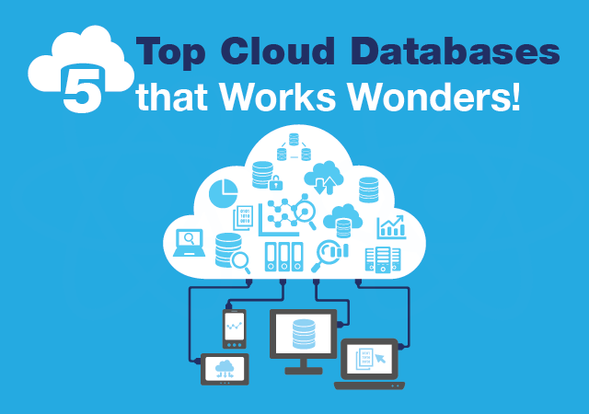

Slide 6


